Slide 2
Write and understand word problems for problem solving.

Slide 3
The metalanguage in grouping word problems
If the sentences that you come up with make sense
If the sentences correctly represent the equation

Slide 4
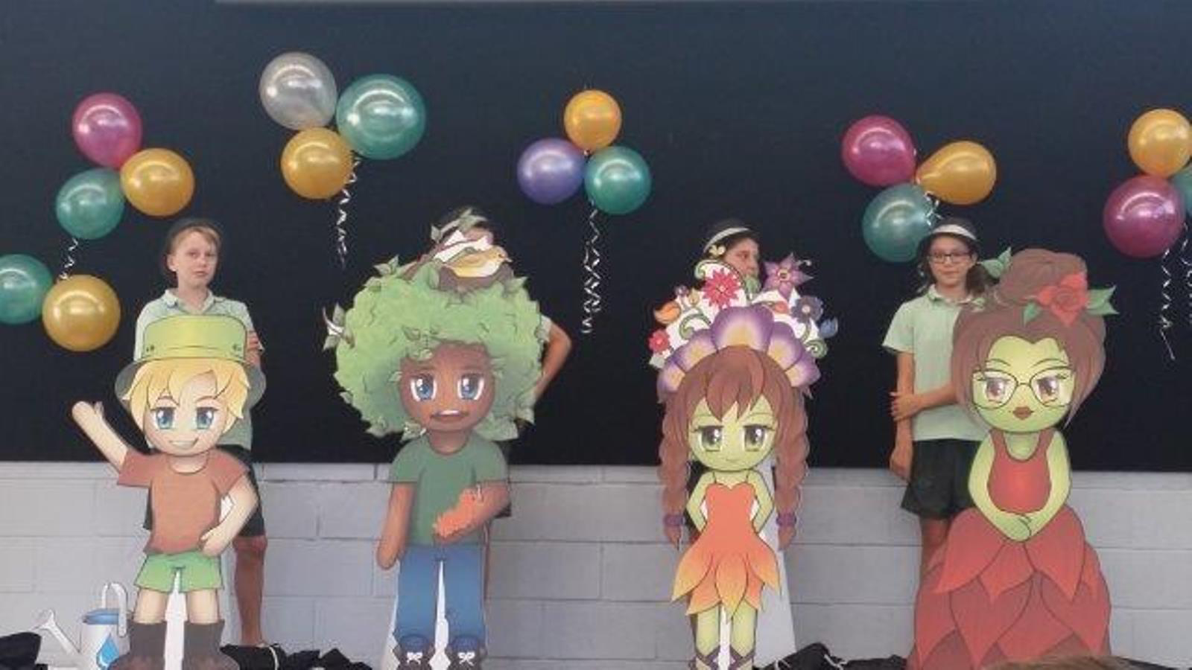
Expectations
What are the Woodlandian Values?

Slide 6
Number Sentence
18 3 =

Slide 7
Word Problem
There are 18 students working in groups of three. How many groups are there?

Slide 8
There are 6 groups so…
18 3=6

Slide 9
You have a go…
16 4=

Slide 10
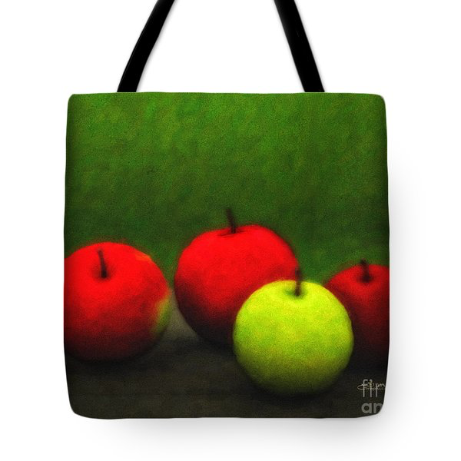
My word problem
The farmer had 16 apples and put 4 in each bag.
How many bags are there?

Slide 11
Have a go..
24 4=

Slide 12
24 4=6

Slide 13
Rally Coaching
What is it?
Why do we do it?

Slide 14
Worksheet

