Slide 1
Guess the Shape!

Slide 2
What am I?
I have 6 faces.
I have 8 vertices.
I have 12 edges.
My faces are all the same shape.
I am a cube!

Slide 3
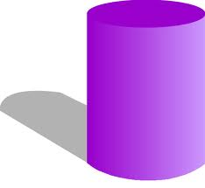
What am I?
I have 1 curved face.
I have 2 circular faces.
I have 0 vertices.
I am a cylinder!

Slide 4
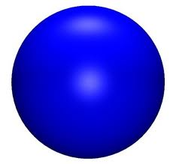
What am I?
I have 1 curved face.
I have 0 vertices.
I have 0 edges.
I am a sphere!

Slide 5
What am I?
I have 6 faces.
I have 8 vertices.
4 of my faces are rectangles.
I have 12 edges.
I am a cuboid!

Slide 6
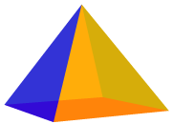
What am I?
I have 5 faces.
4 of my faces are triangles.
I have a square base.
I have 5 vertices.
I have 8 edges.
I am a pyramid!

Slide 7
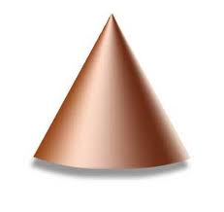
What am I?
I have 1 curved face.
I have 1 circular face.
I have 1 vertex.
I am a cone!

