Slide 1
Journal Writing
15 minutes

Slide 2
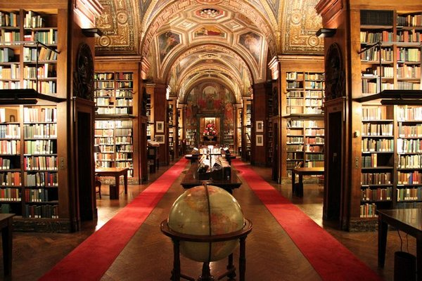
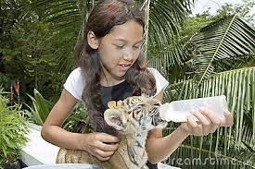
One day I’d like to ……..
NOTE:
To change images on this slide, select a picture and delete it. Then click the Insert Picture icon
in the placeholder to insert your own image.
Why would I like to do this?

Slide 3
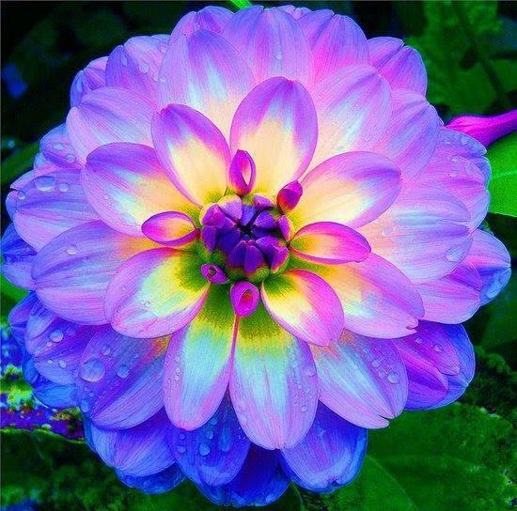
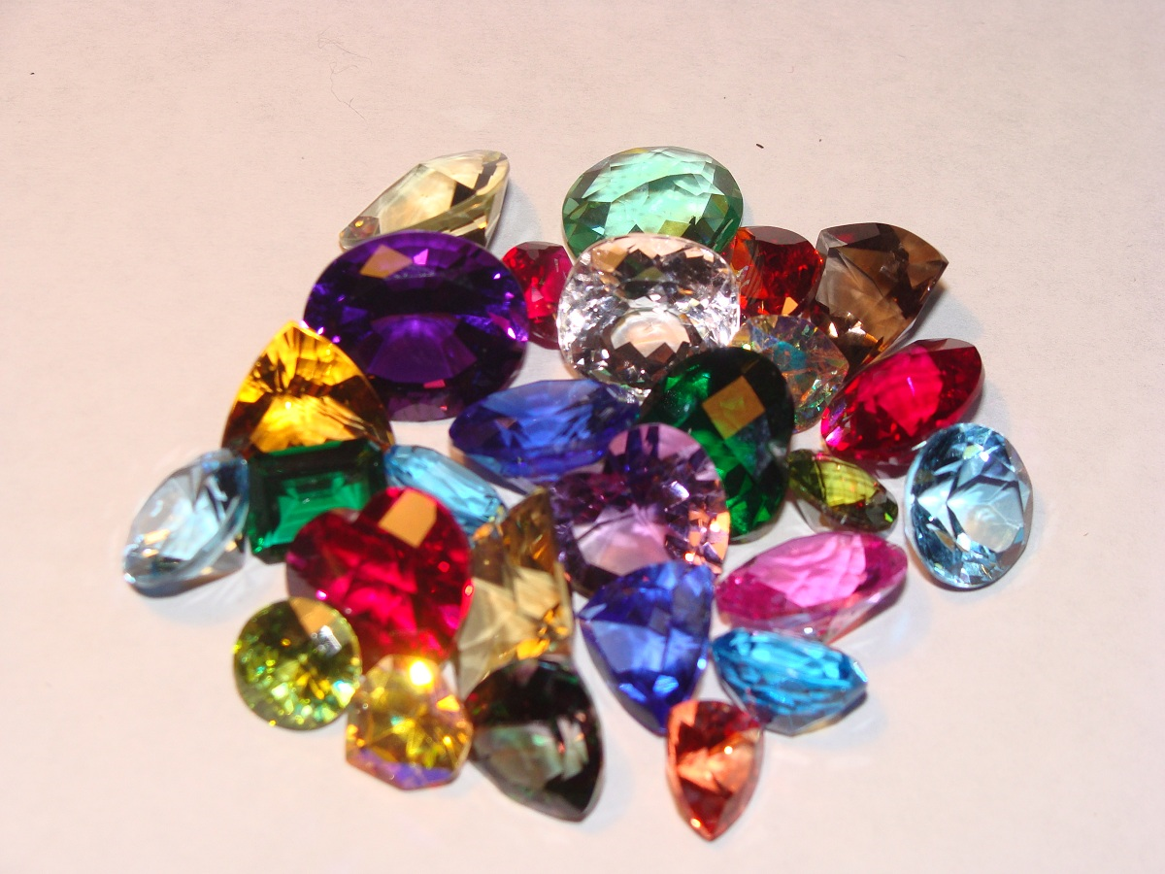
The most beautiful things in the world are …
NOTE:
To change images on this slide, select a picture and delete it. Then click the Insert Picture icon
in the placeholder to insert your own image.
Why is it beautiful? What makes it beautiful?

Slide 4
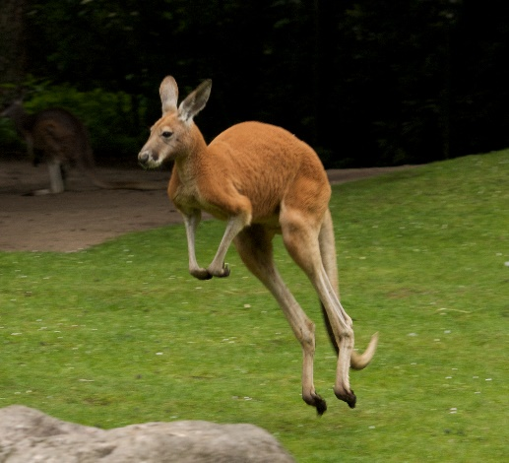
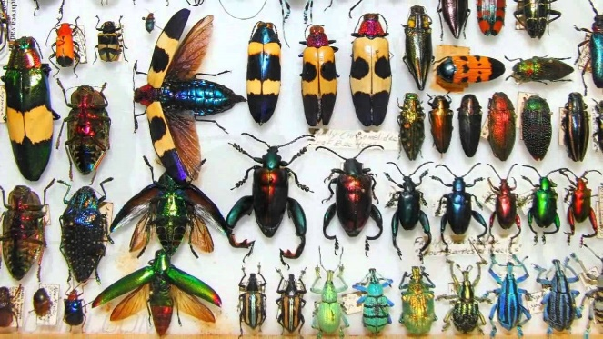
If I were an animal I would …
NOTE:
To change images on this slide, select a picture and delete it. Then click the Insert Picture icon
in the placeholder to insert your own image.
Why this specific animal? What characteristics are appealing to you?

Slide 5
When I am older I would like to be …
NOTE:
To change images on this slide, select a picture and delete it. Then click the Insert Picture icon
in the placeholder to insert your own image.
Why would you like to be this person? What characteristics are appealing to you?

Slide 6
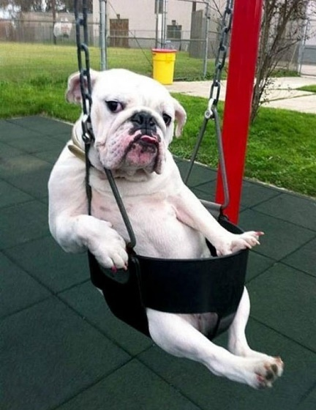
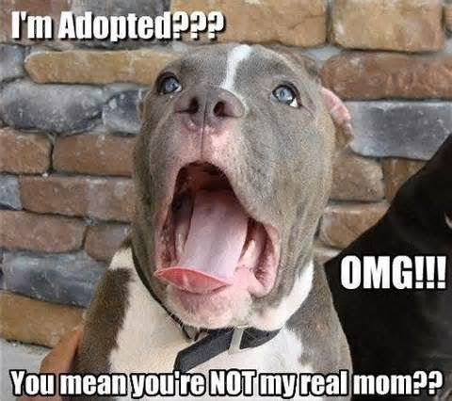
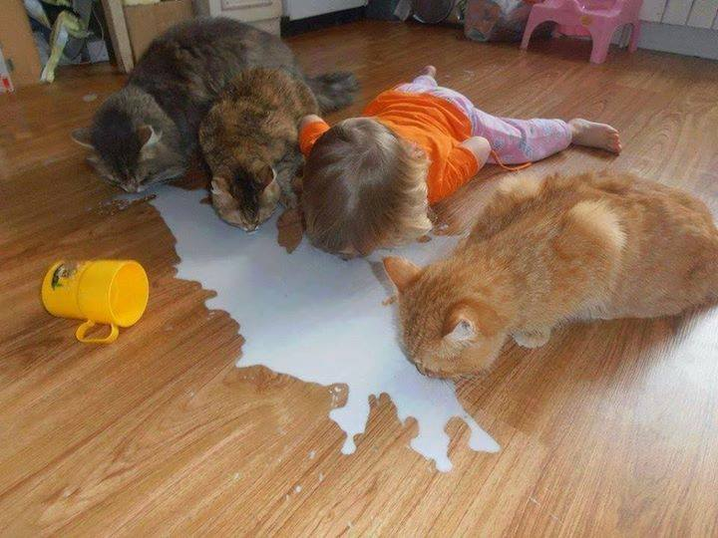
The funniest thing I ever saw was …
NOTE:
To change images on this slide, select a picture and delete it. Then click the Insert Picture icon
in the placeholder to insert your own image.
Why was it funny? What happened to make it funny?

Slide 7
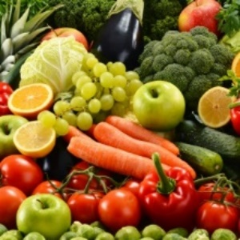
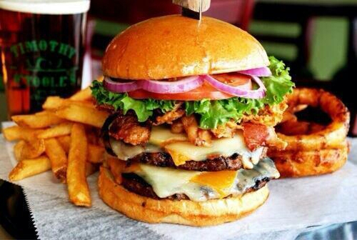
My favourite food is …
NOTE:
To change images on this slide, select a picture and delete it. Then click the Insert Picture icon
in the placeholder to insert your own image.
Why is it my favourite food? When do I like to eat it?

Slide 8
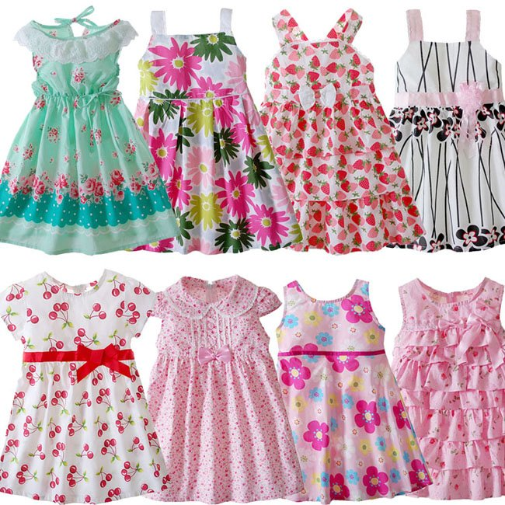
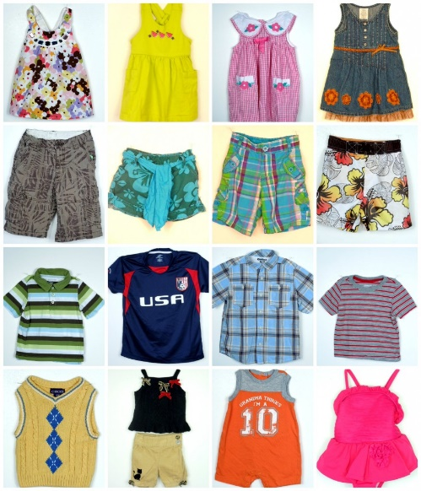
The piece of clothing I like best of all is my…
NOTE:
To change images on this slide, select a picture and delete it. Then click the Insert Picture icon
in the placeholder to insert your own image.
What makes it your favourite?

