Slide 1
Measuring Length
Notes:
This presentation demonstrates the new capabilities of PowerPoint and it is best viewed in Slide Show. These slides are designed to give you great ideas for the presentations you’ll create in PowerPoint 2011!
For more sample templates, click the File menu, and then click New From Template. Under Templates, click Presentations.

Slide 2
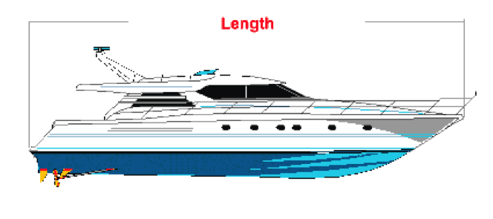

Slide 7
What can we use to measure?

Slide 8
Uniform Measurement
What does uniform mean?

Slide 10
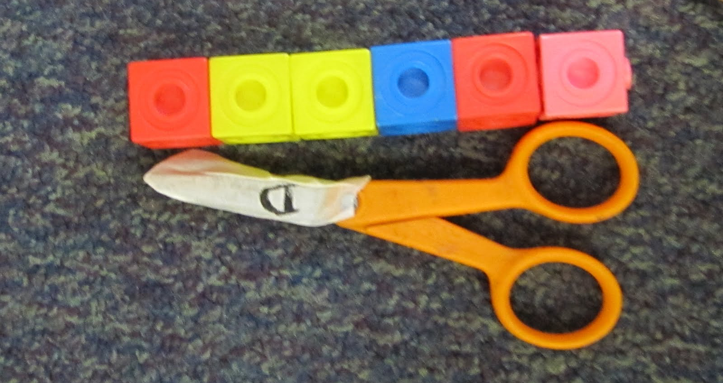

Slide 11
Use Initiative
Make the right choices
Be responsible
Be respectful

Slide 12
Lets Get Measuring…

