Slide 1
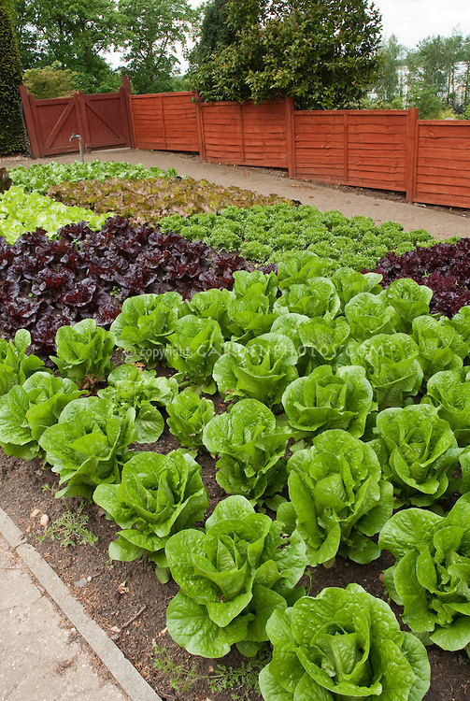
My favourite No!
Lettuce Arrays
Mr Greenthumbs has 16 lettuce settlings. He wants to plant them in EQUAL rows.
How many different ways can Mr Greenthumbs plant his seedlings?
Use whiteboards.

Slide 2
My favourite No!
Arrays
Can you use your knowledge of arrays to work out the total number of counters.
The white sheet of paper is covering the other counters.
Describe how you worked it out.
Use whiteboards.

Slide 3
My favourite No!
Using the numbers provided create the largest and smallest possible numbers.
1.
2.
3.
9
5
6
2
2
4
7
0
3
1
8
5

Slide 4
My favourite No!
Addition Strategies
Can you tell me four different ways to add 19 + 23?
Use A4 sheet of paper.
19 + 23

Slide 5
My favourite No!
Addition Strategies
Can you tell me four different ways to add 19 + 23?
26 + 32

