Slide 1
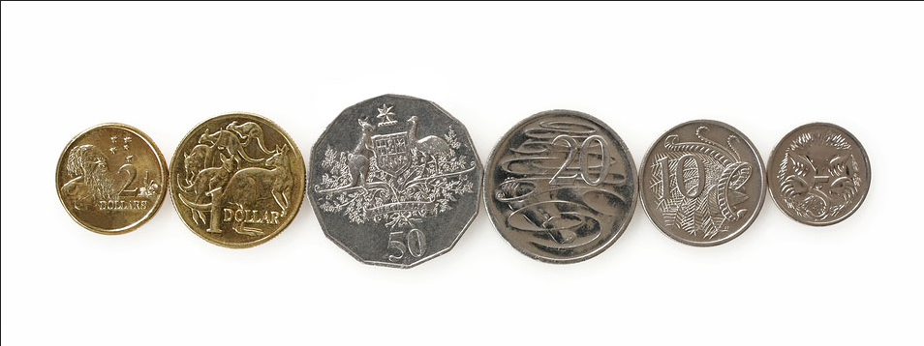
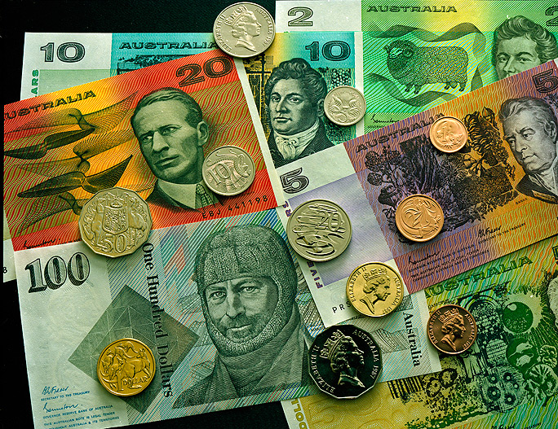
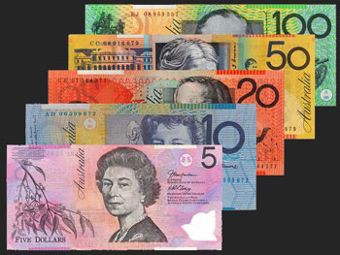
Money

Slide 2
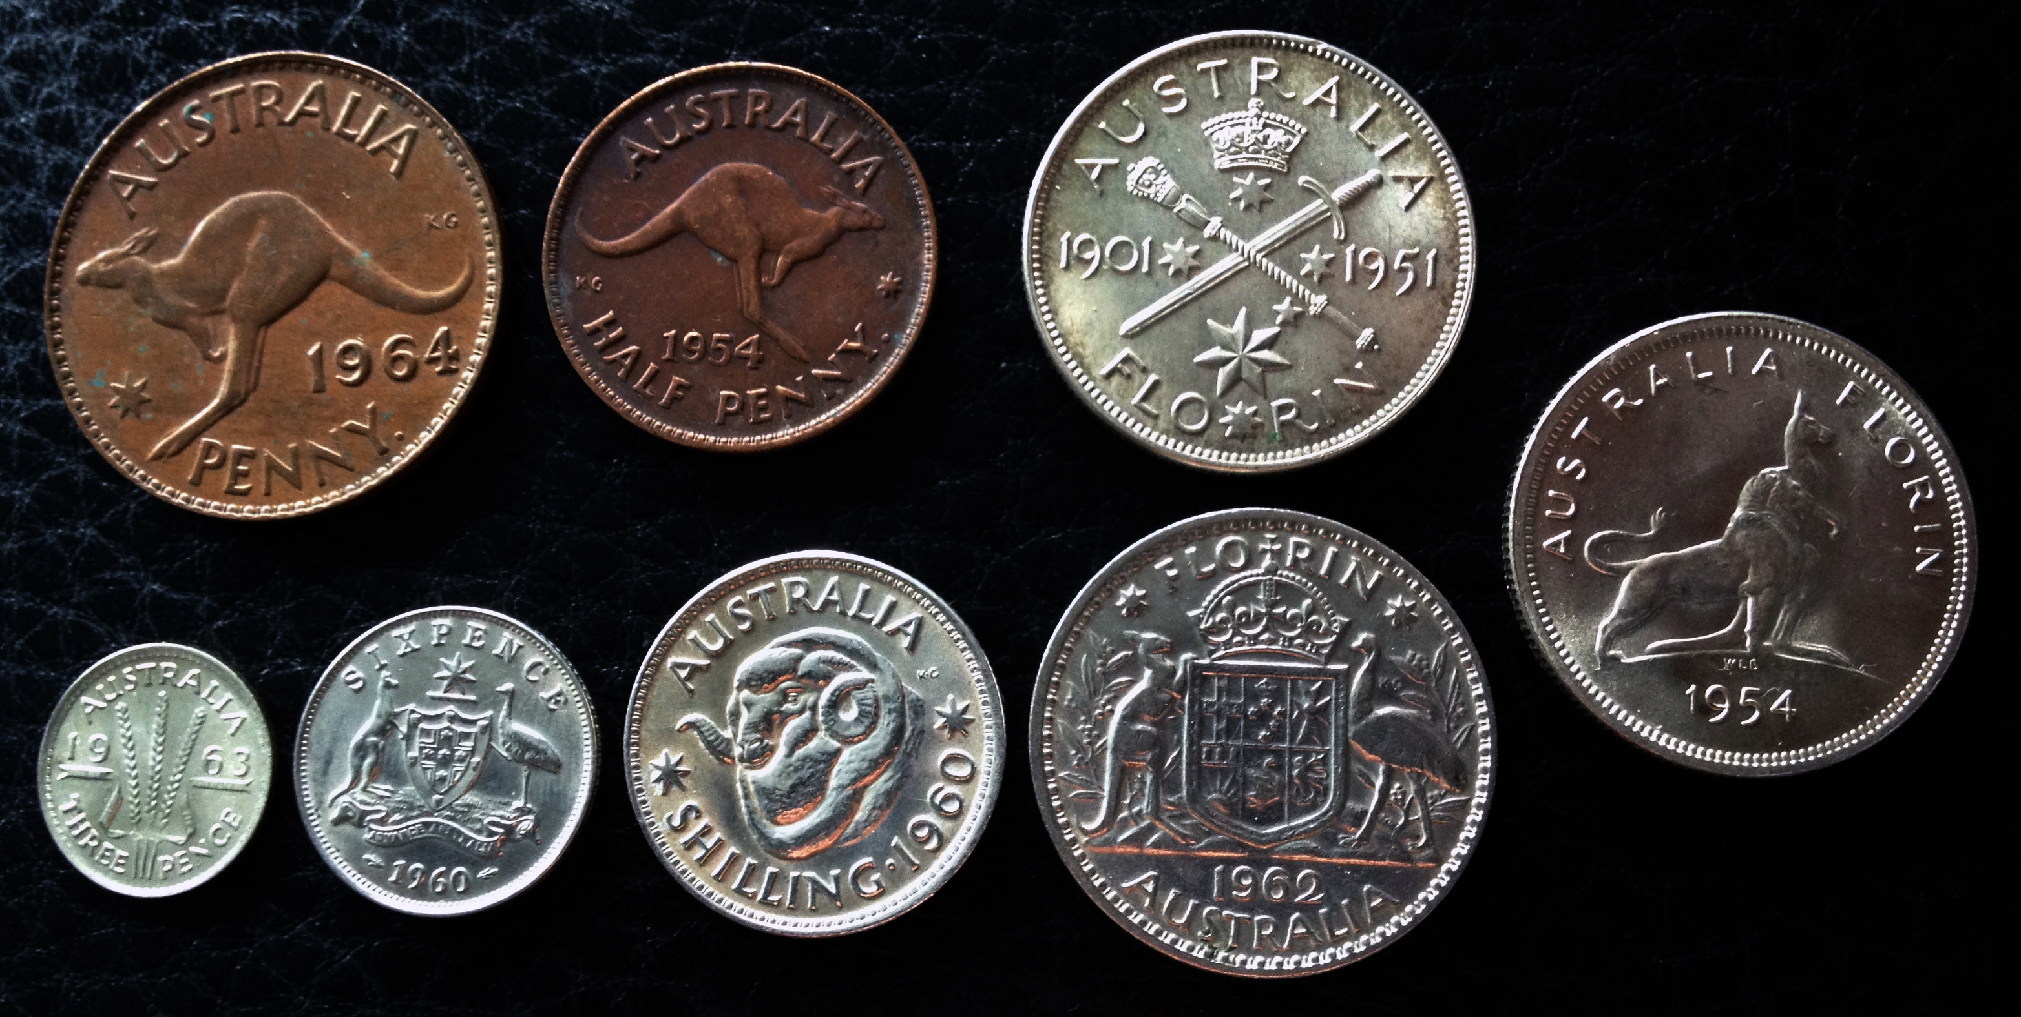
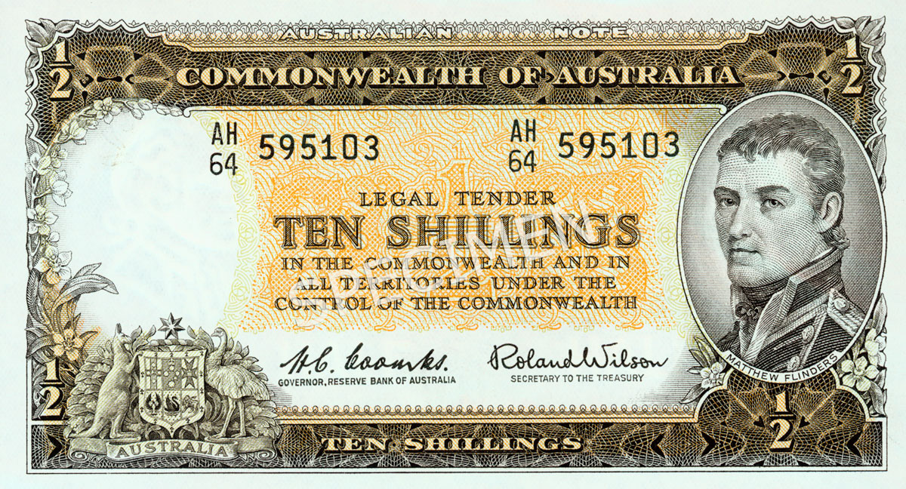
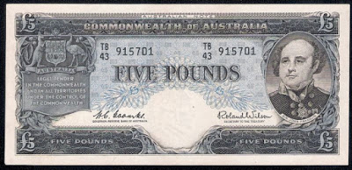
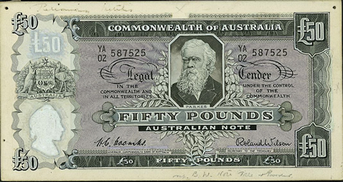
Very Old Currency

Slide 3
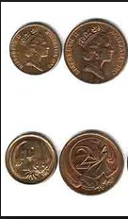
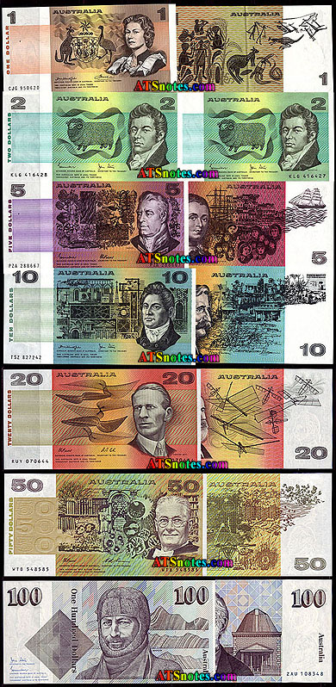
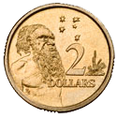
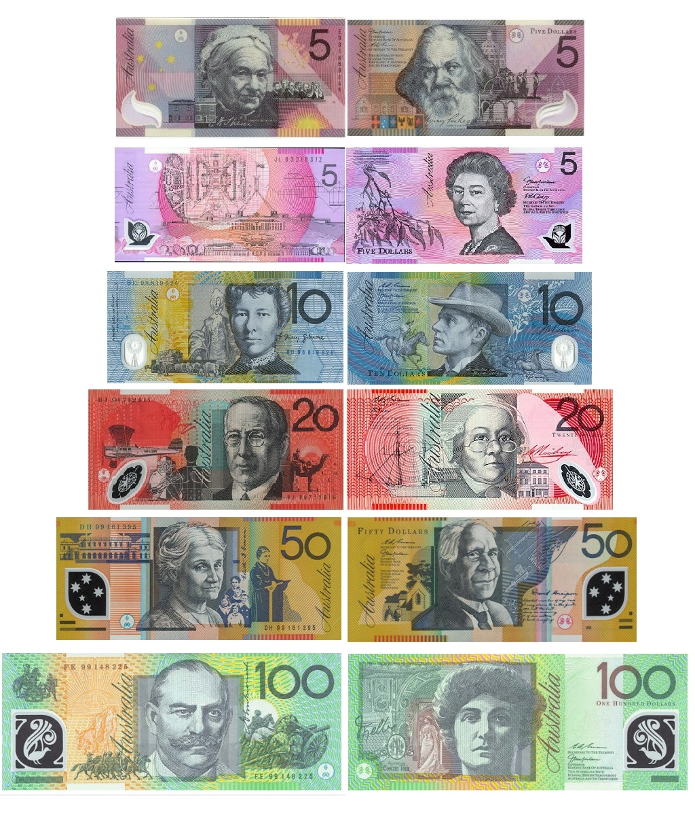
Old – Out of Circulation
New - Circulating

Slide 4
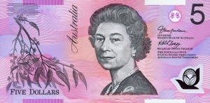
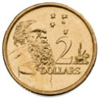
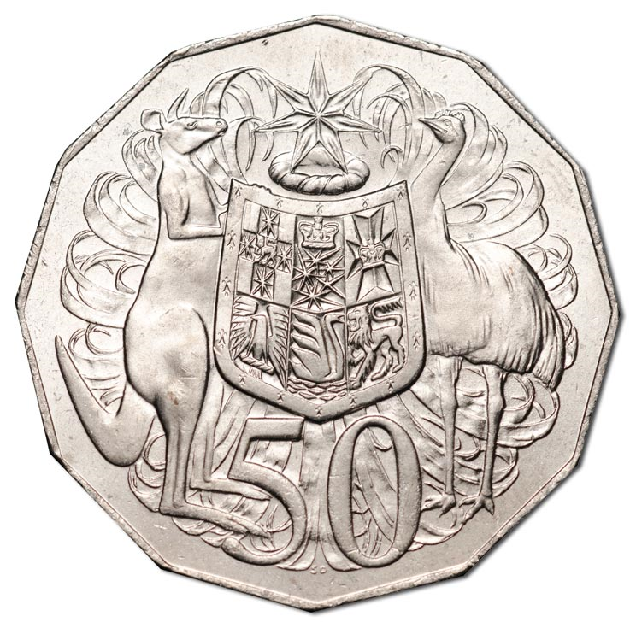
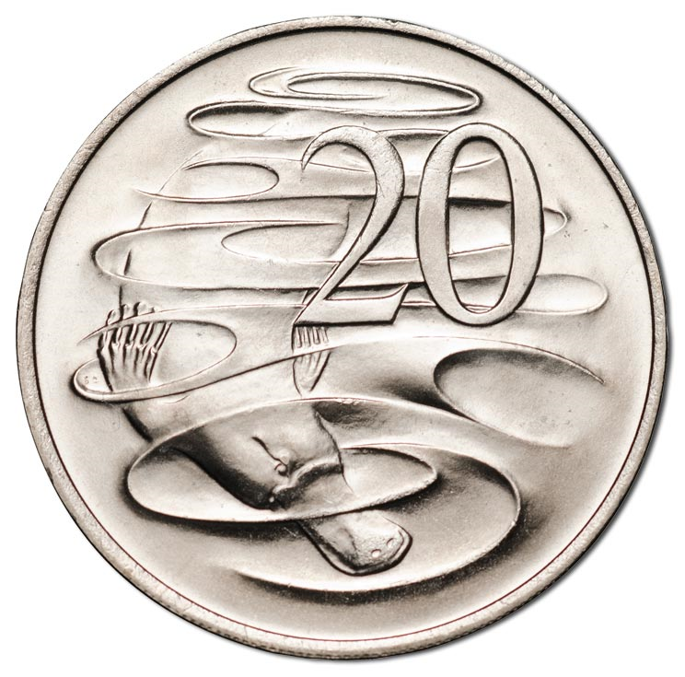
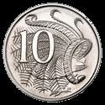
Different combination to represent an amount.
Divide your A3 page into quarters.
$5.00 | $5.00
$5.00 | $5.00

Slide 5
Each member in the team will have a new number to share back with the group and explain the different grouping.
$25.00
$15.00
$10.00
$2.00
$27.00
$18.00
$13.00
$6.00
$32.00
$21.00
$16.00
$9.00

Slide 6
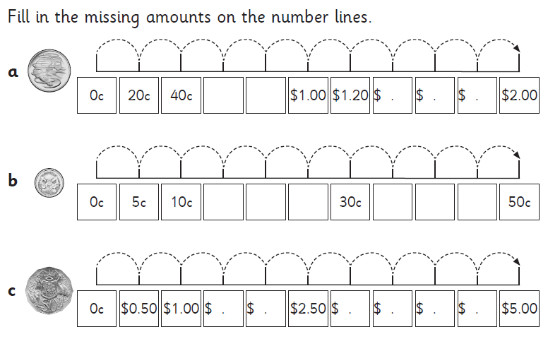
Skip Counting – Using whiteboard or exercise book to record your answers.

Slide 7
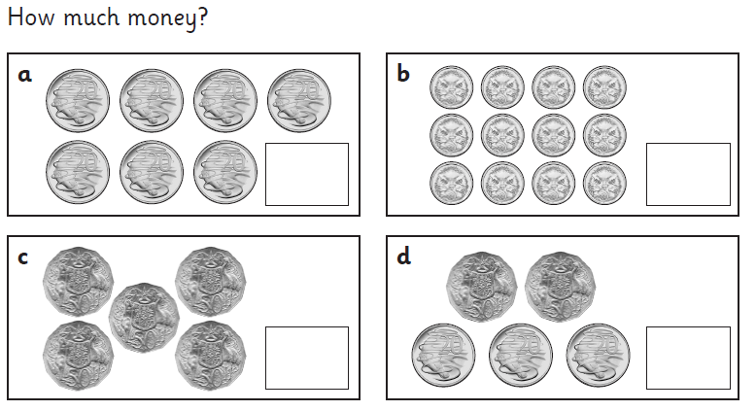
Skip Counting

Slide 8
Skip Counting – Rally Coach
How many $5.00 do I need to make $20.00.
How many $10.00 do I need to make $120.00
How many $20.00 do I need to make $200.00
How many $50.00 do I need to make $500.00

Slide 9
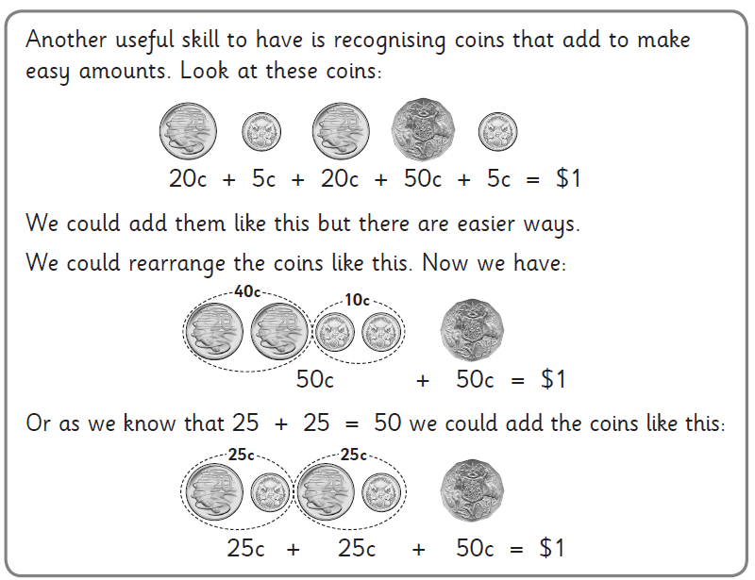
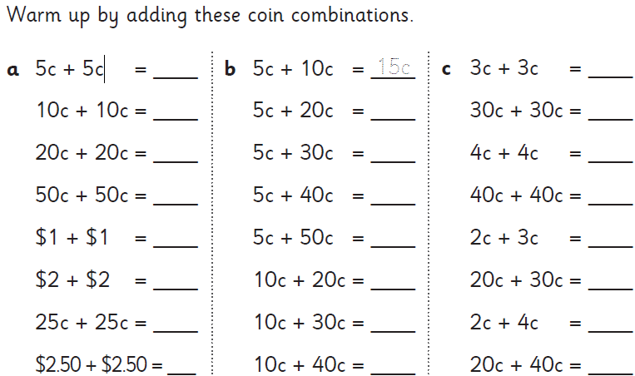
Money – Adding coins

Slide 10
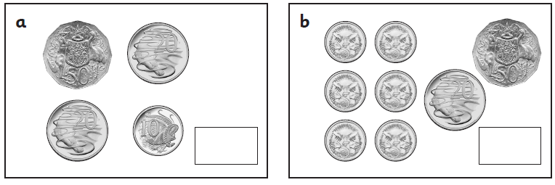
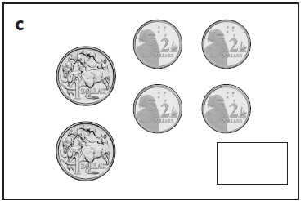
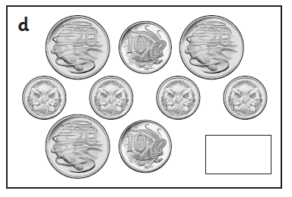
Warm up
Solve the following

Slide 11
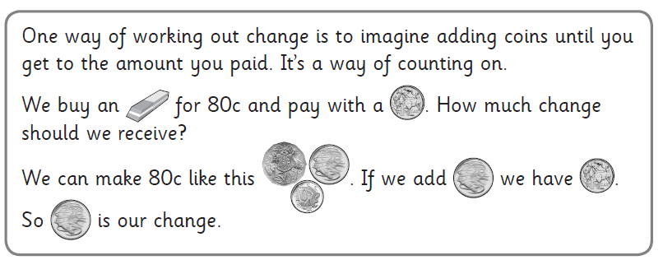
Money – Change, Counting On Strategy

Slide 12
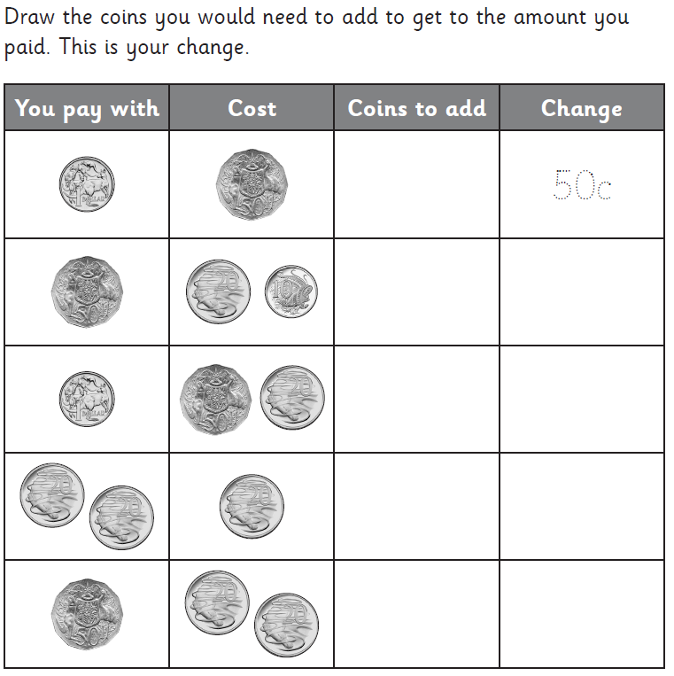
Lets complete the table together Your turn complete page 38

